Slide 1
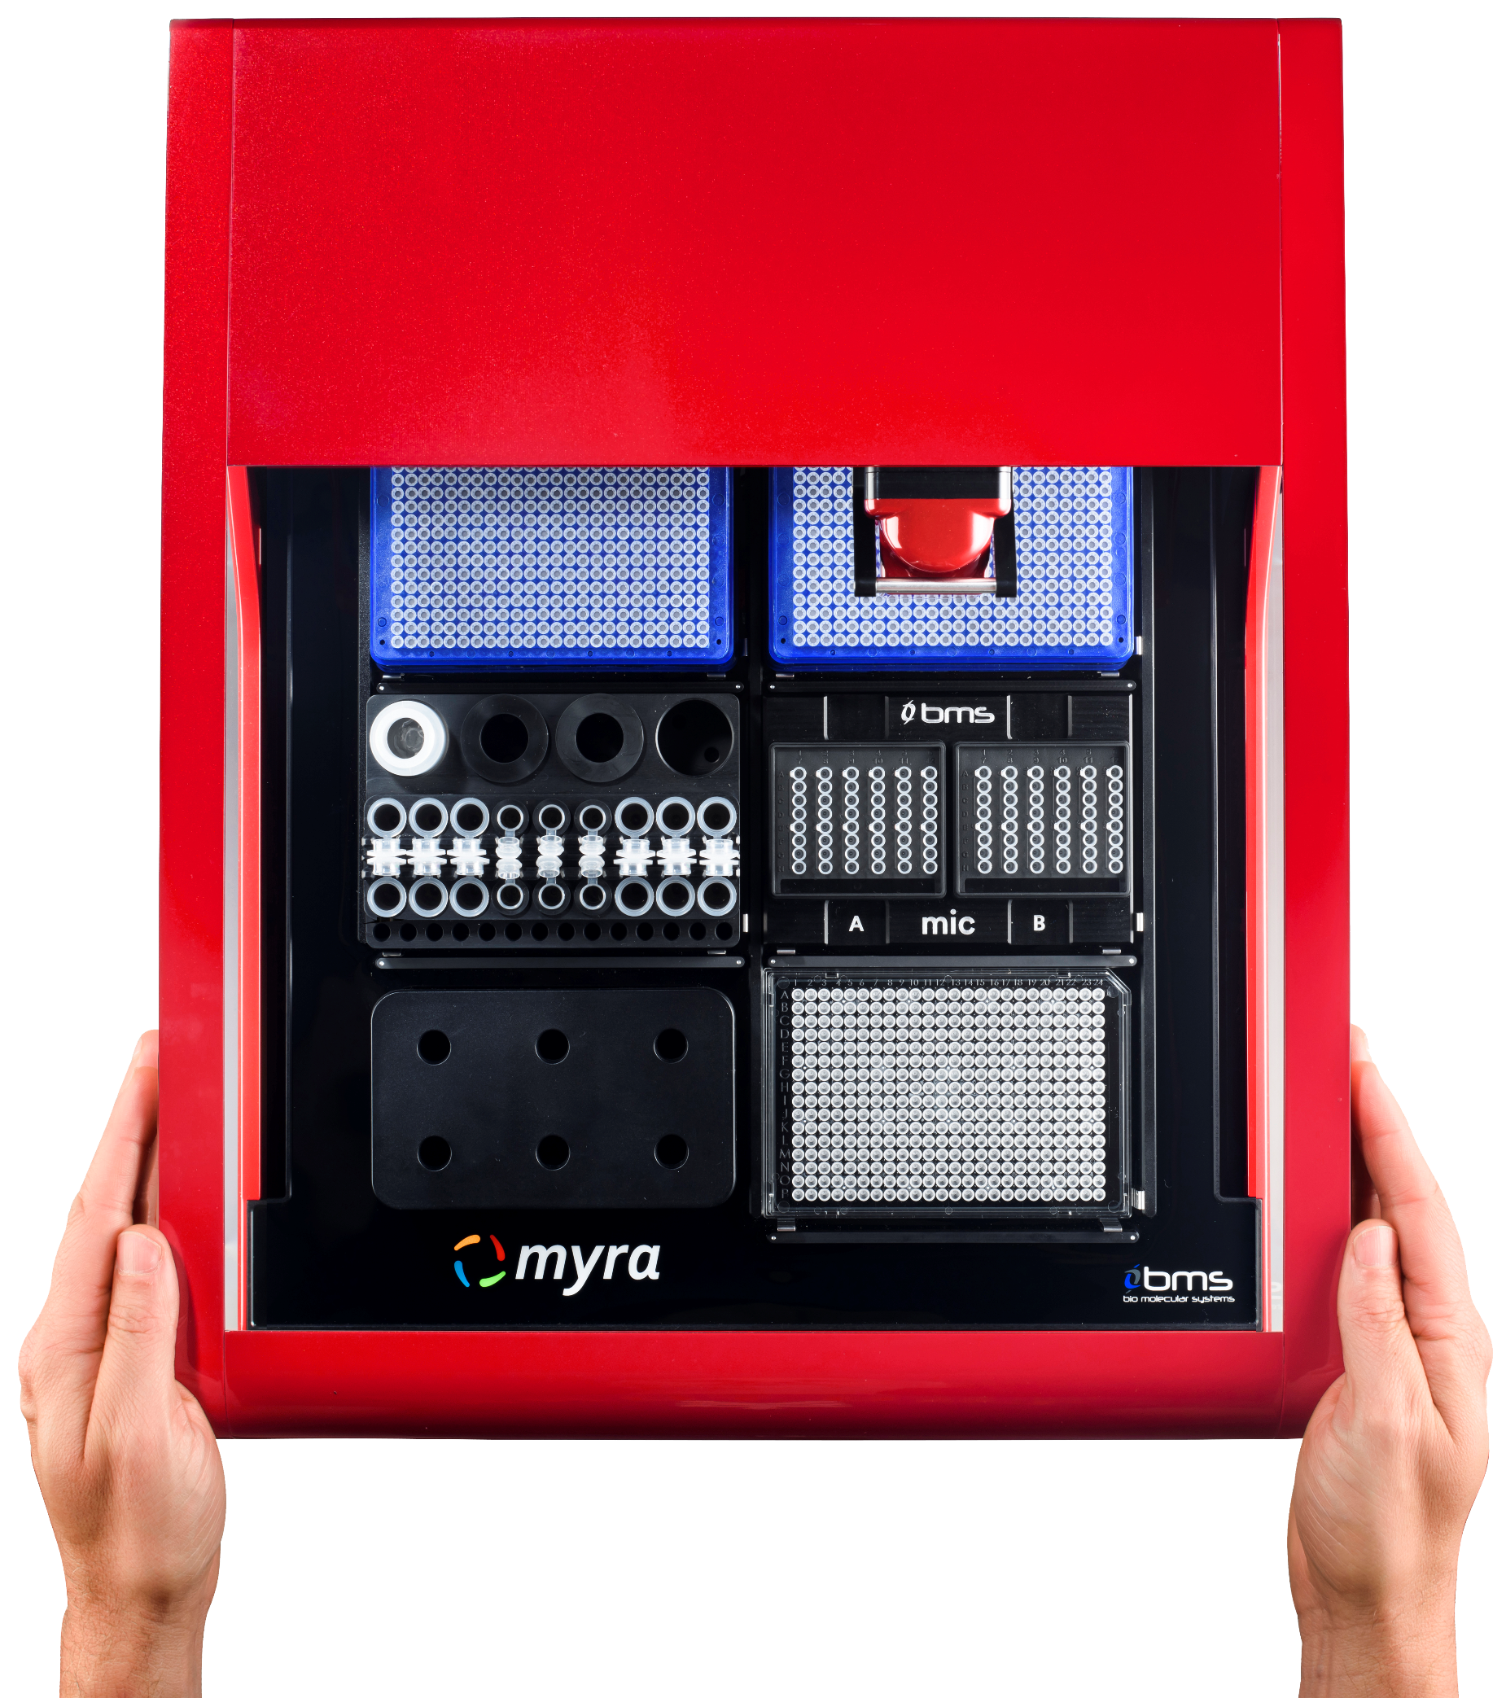
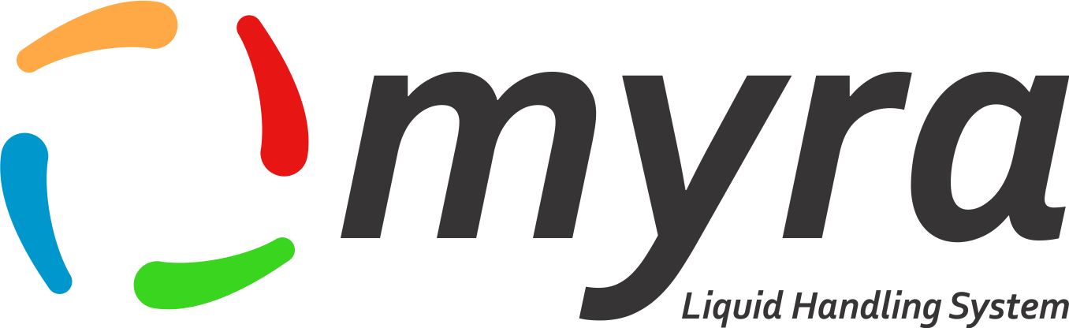

Introduction to Myra
November 2018
All information within this presentation is subject to change.
© 2018 Bio Molecular Systems Pty. Ltd. – All rights reserved

Slide 2
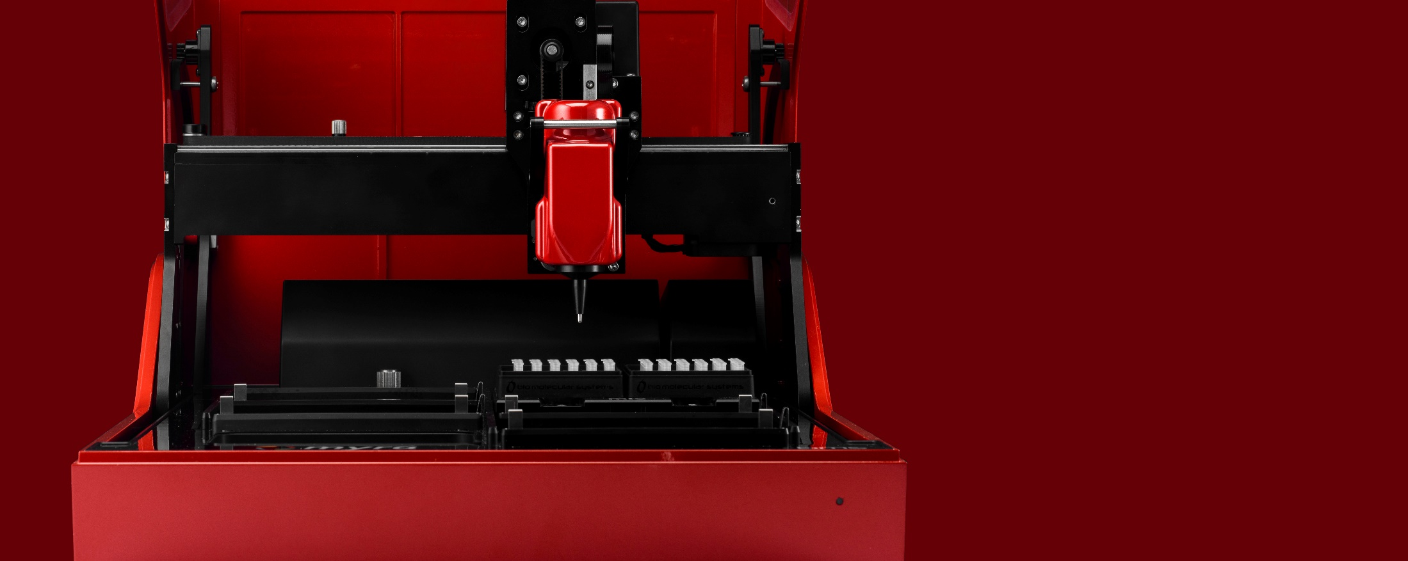
An intelligent liquid handling system for every lab lab.
Meet Myra
Simplicity | Performance | Size
Seamlessly integrated with Mic
Outstanding pipetting precision and accuracy
Incredibly powerful in a compact size
Comes standard with UV and HEPA

Slide 3
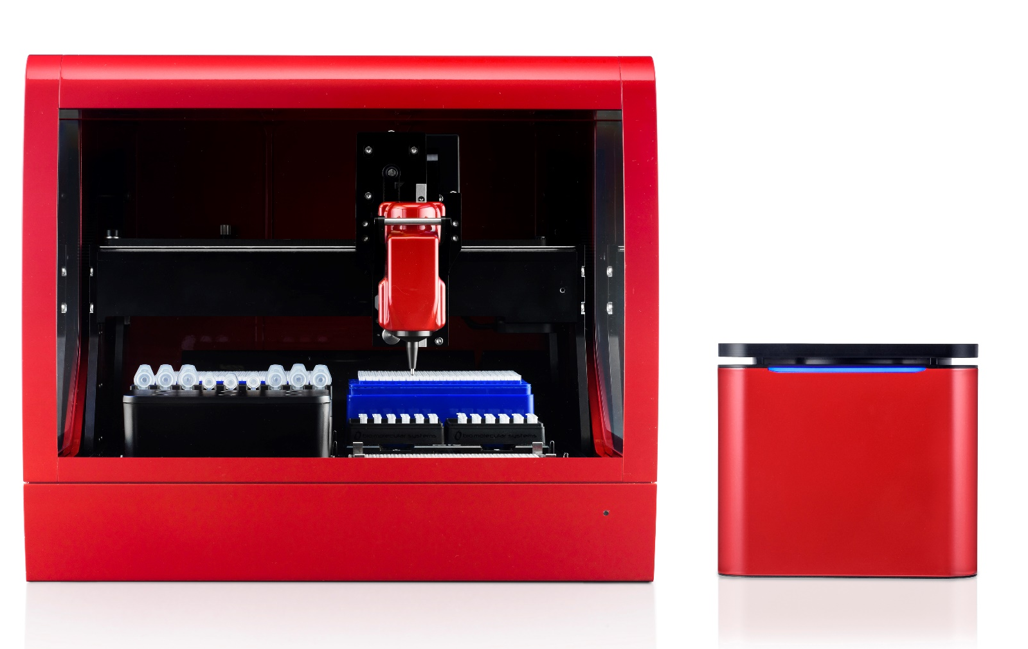
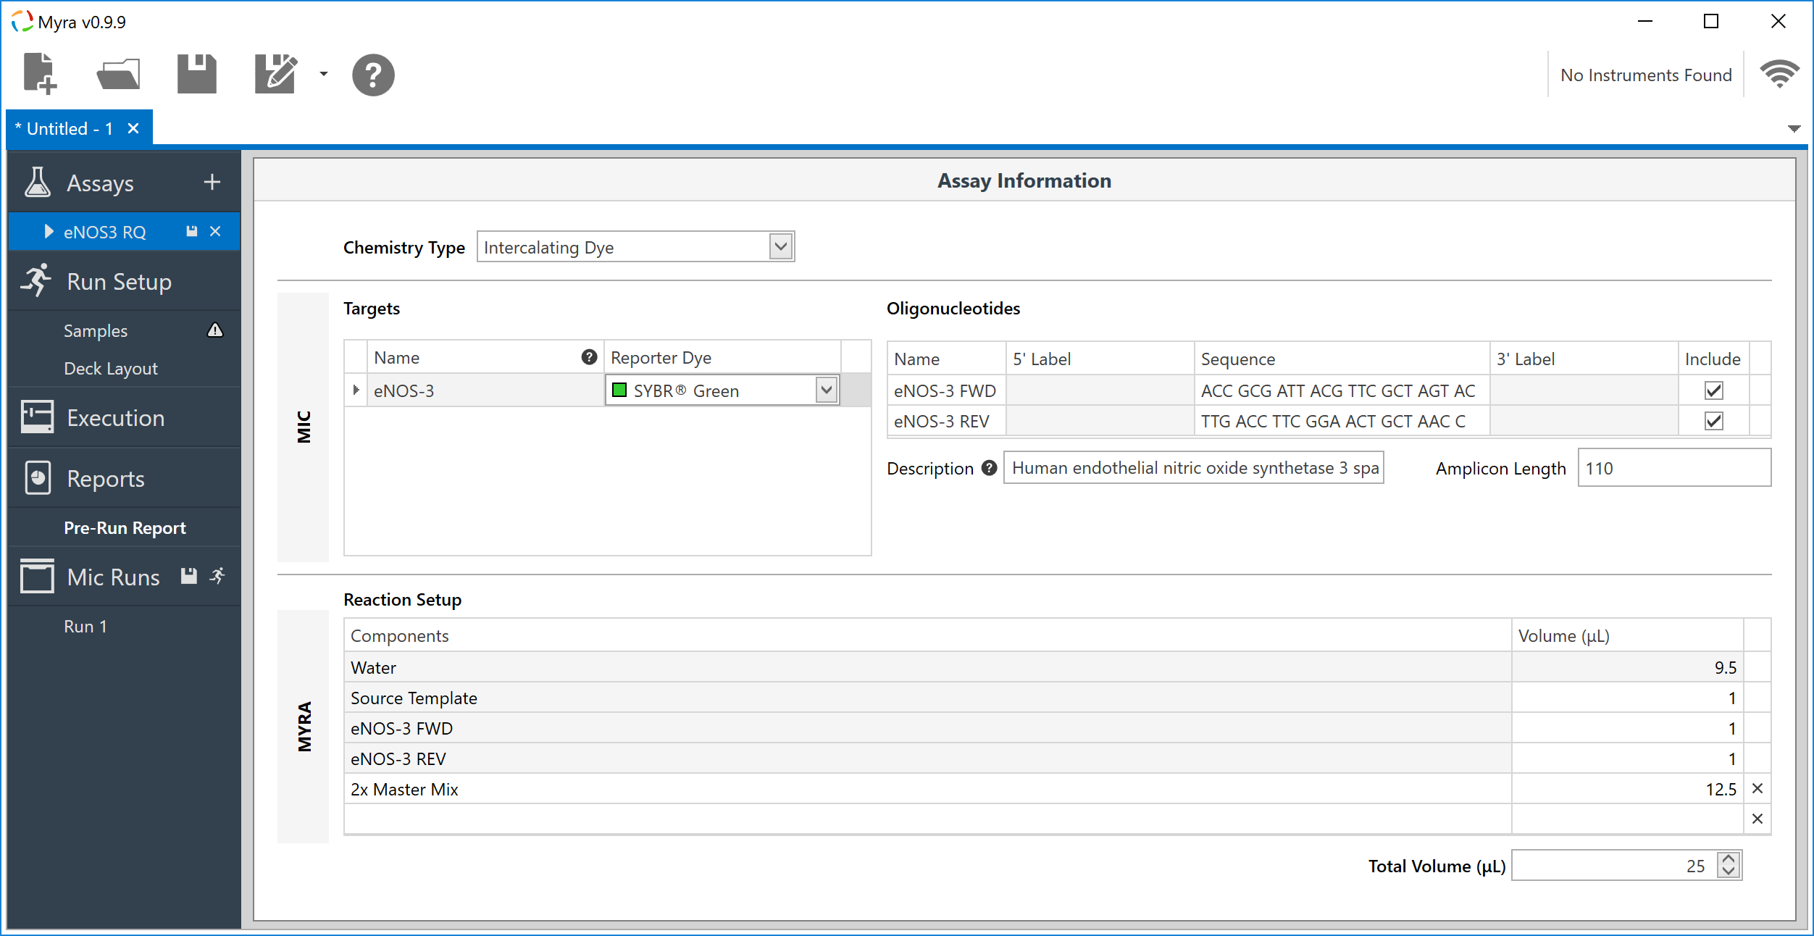
Simplicity
A perfectly seamless workflow between the Myra liquid handling system and Mic cycler for qPCR setup.
No exporting or importing of sample names required. Just setup, run, and analyse
Integrated software under development.

Slide 4
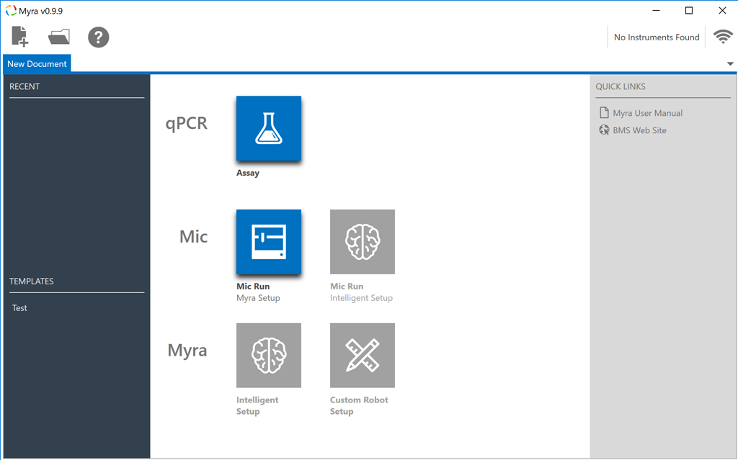
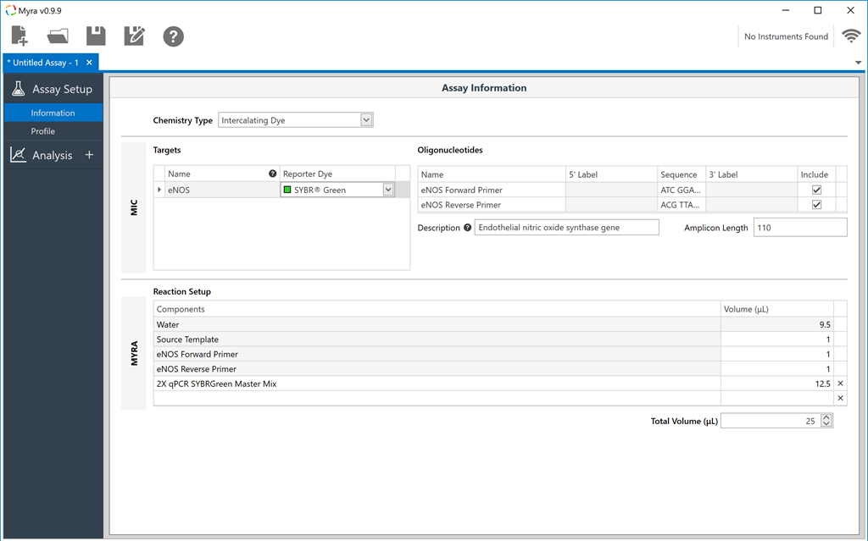
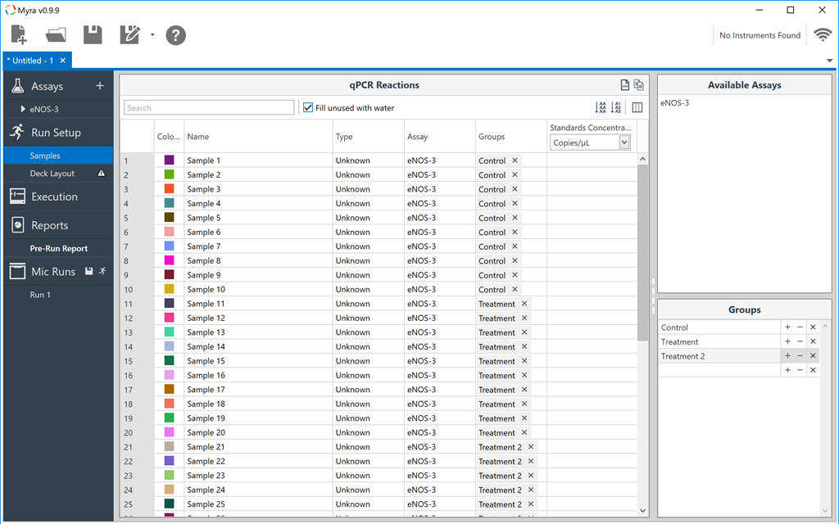
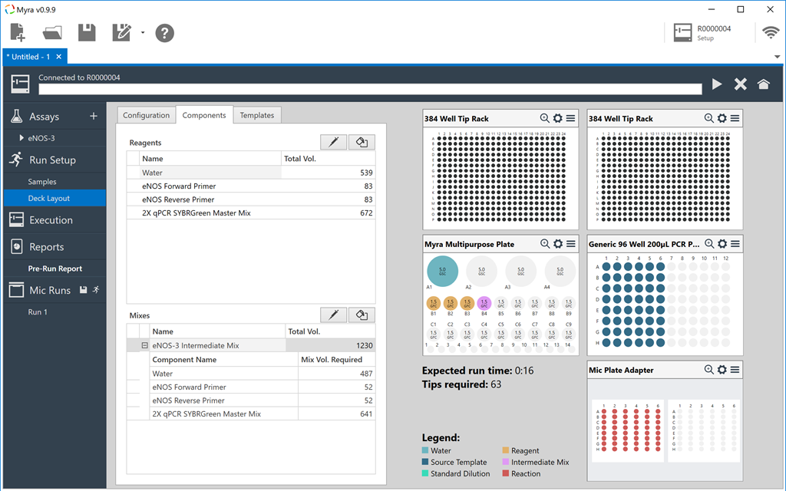
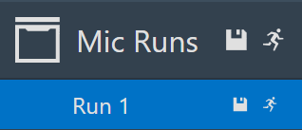
Easy to Use Software
Select from menu options.
Create your assay including pipetting setup, Mic profile and analysis setting.
Annotate samples and/or standards.
…simple!
Start the Mic run directly from the Myra software.
Setup the deck and begin setup on the Myra.

Slide 5
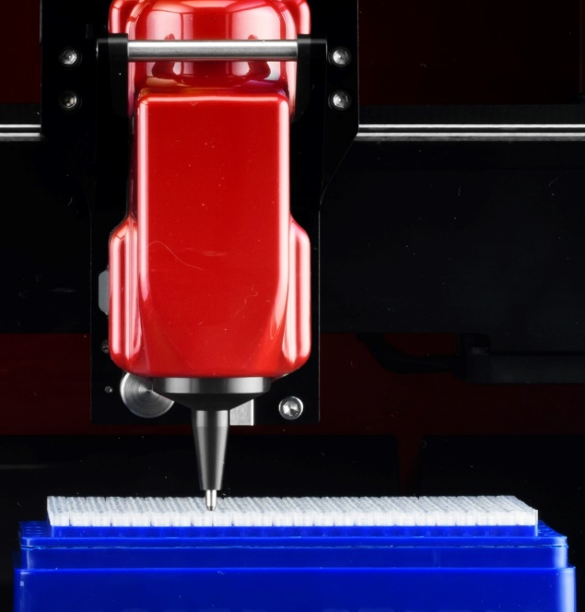
State of the Art Hardware
Vision system
Closed loop axis control with advanced path planning and error detection.
High precision pipette tip positioning for small aperture tubes such as 384 well plates.
Using 384 well pipette tips means you swap out tip racks and we tub less often.
Long life UV LED, easy replacement HEPA Filter system and closed waste tub reduce the risk of contamination.

Slide 6
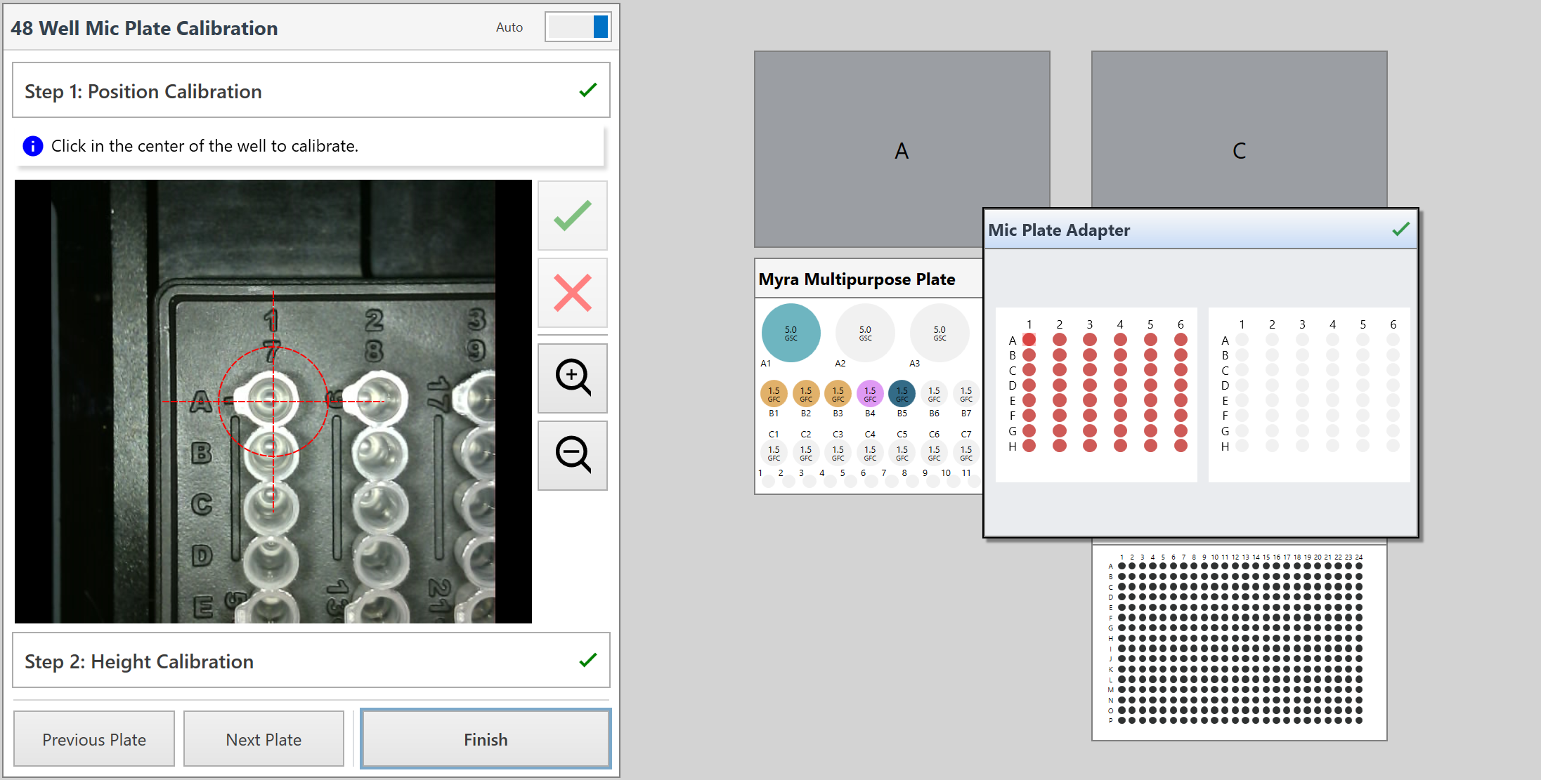
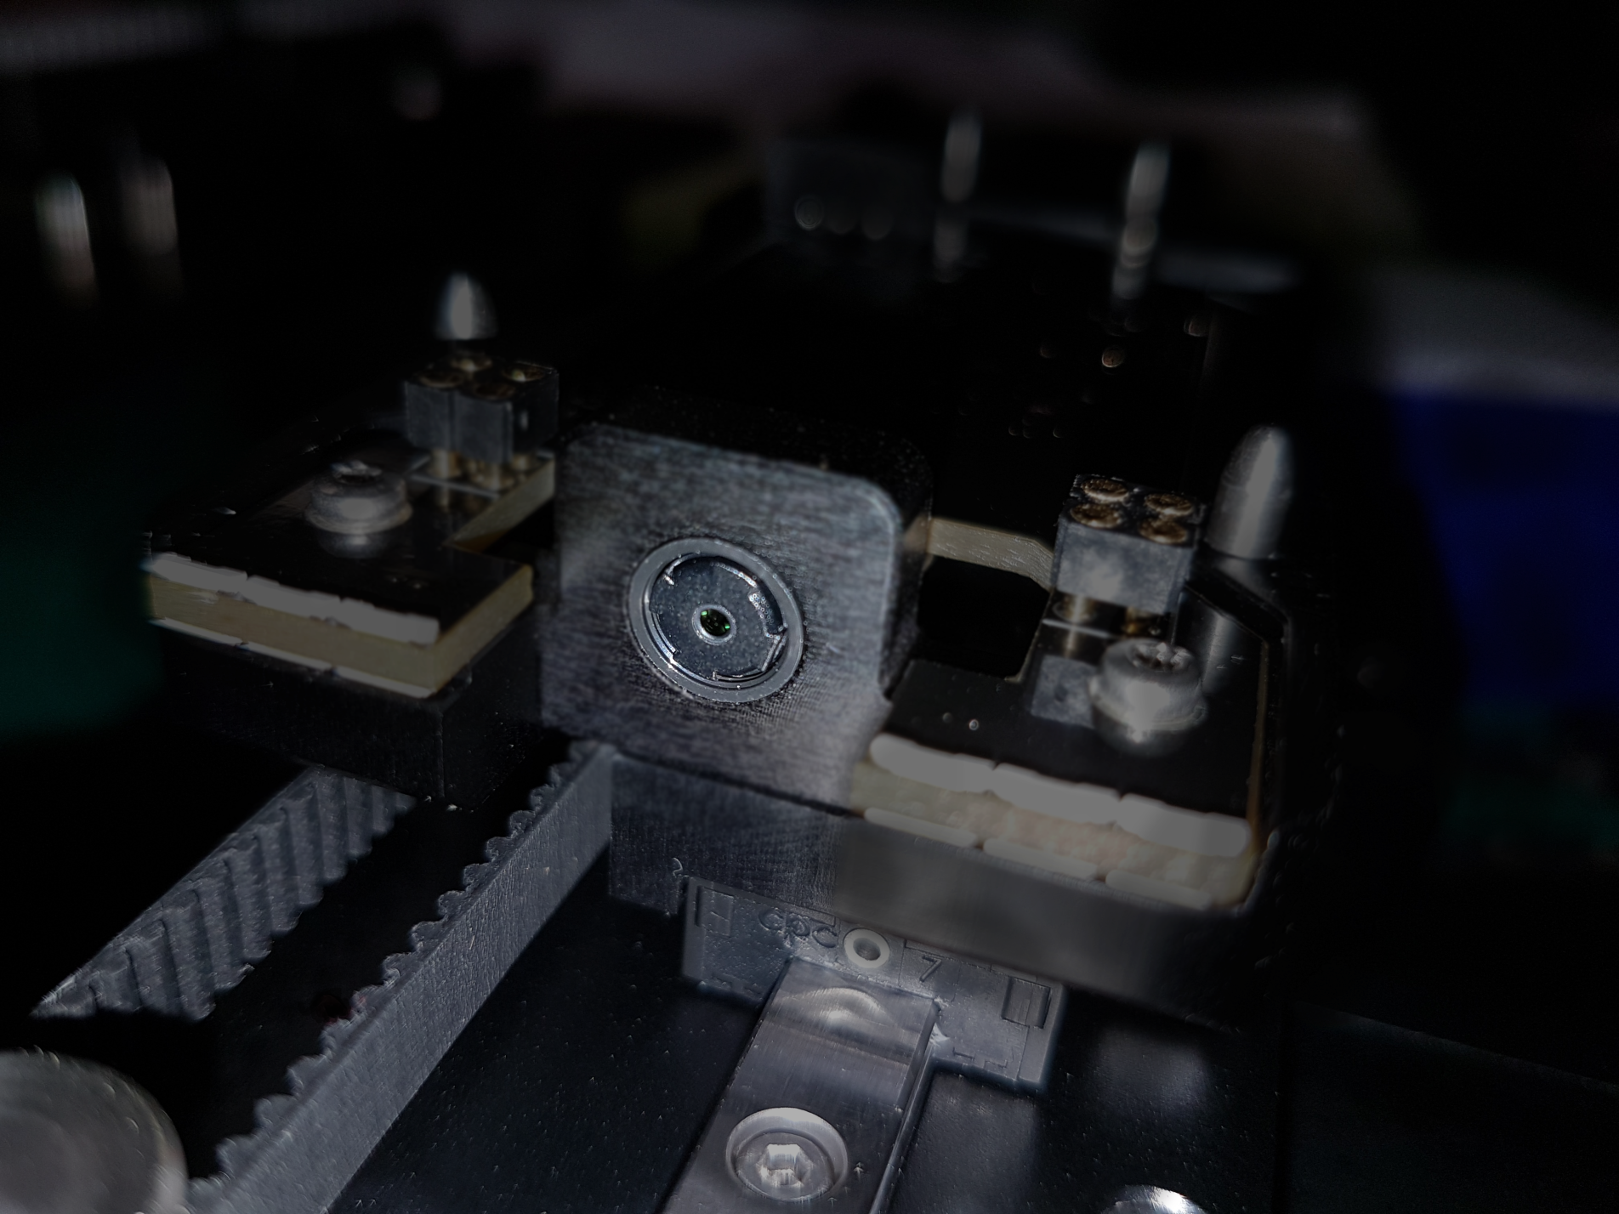
Integrated Vision System
The first pipetting robot that can see!
Single click plate calibration.
No more sticking your head under the hood and eye balling the pipette tip positions. Myra does it all for you.
Advanced imaging functions under development:
Automatic calibration verification.
Barcode and plate identification.
Missing tube and closed cap detection

Slide 7
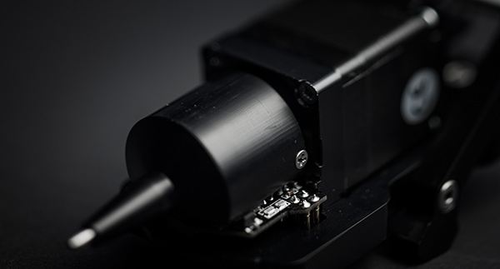
Modular Pipette
Each Interchangeable pipette head contains its own calibration data and controller. Swap and go.
Zero downtime for calibration.
Dispense 1 – 50 µL with exceptional accuracy and precision.
Pressure based liquid level sensing that can monitor the aspirate and dispense process for errors. No need for conductive tips!
Integrated ejection and closed waste container.

Slide 8
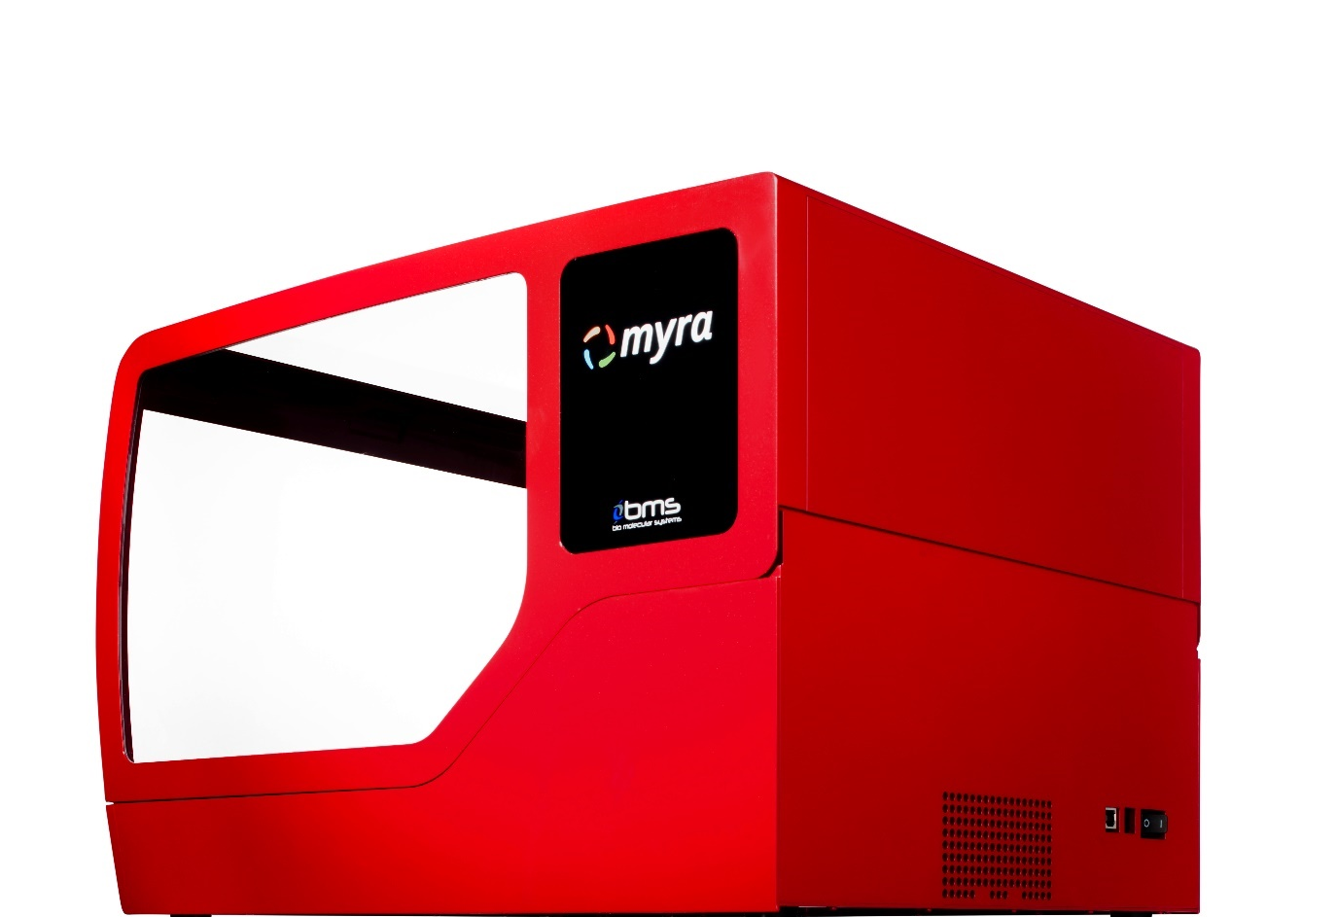
Size
A dynamic design with style and function
At only 10 kg and a footprint of less than 1700 cm², Myra is half the size of other in class liquid handling systems.
Practical and cost effective to ship for demonstrations and trials.
No setup required. Remove from box and start pipetting.
310 mm
460 mm
360 mm

Slide 9
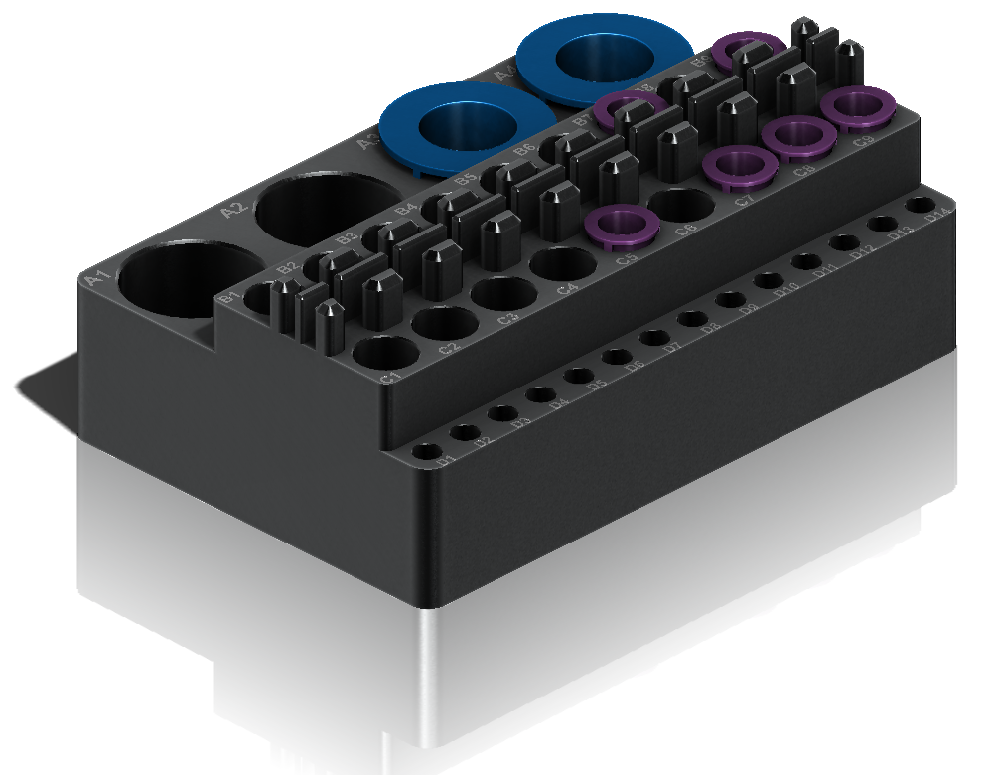
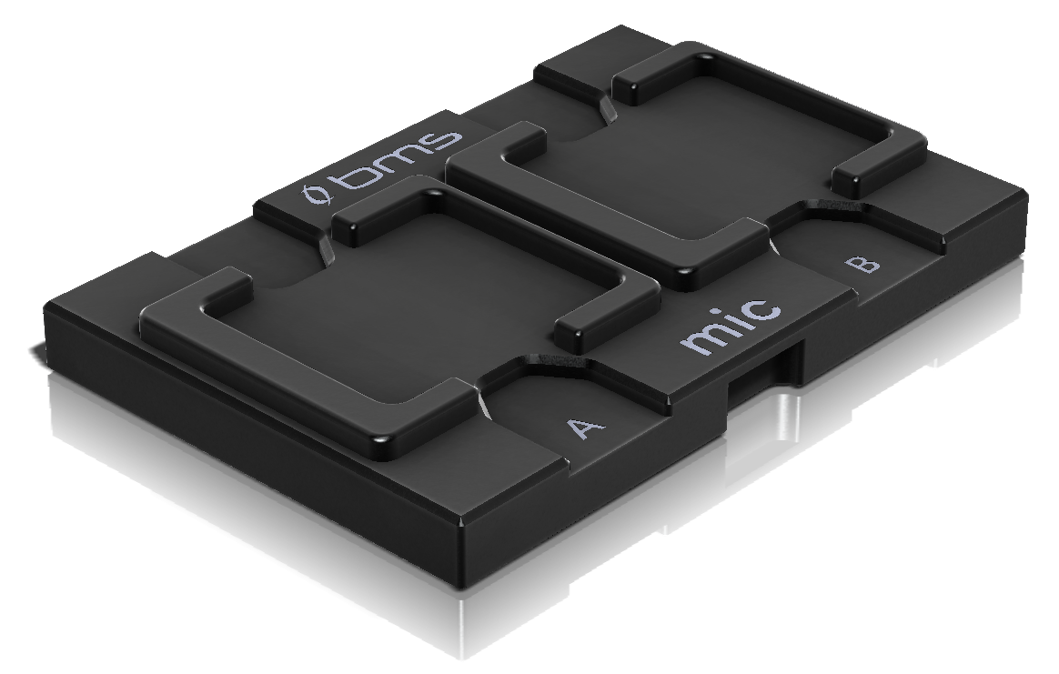
Accessories and Consumables
Everything you need.
Multi-functional Myra Block gives flexibility in setup without compromising space.
Add your own plate or tube type to the library.
Future accessories for NGS Library prep and nucleic acid extraction in development.

Slide 10
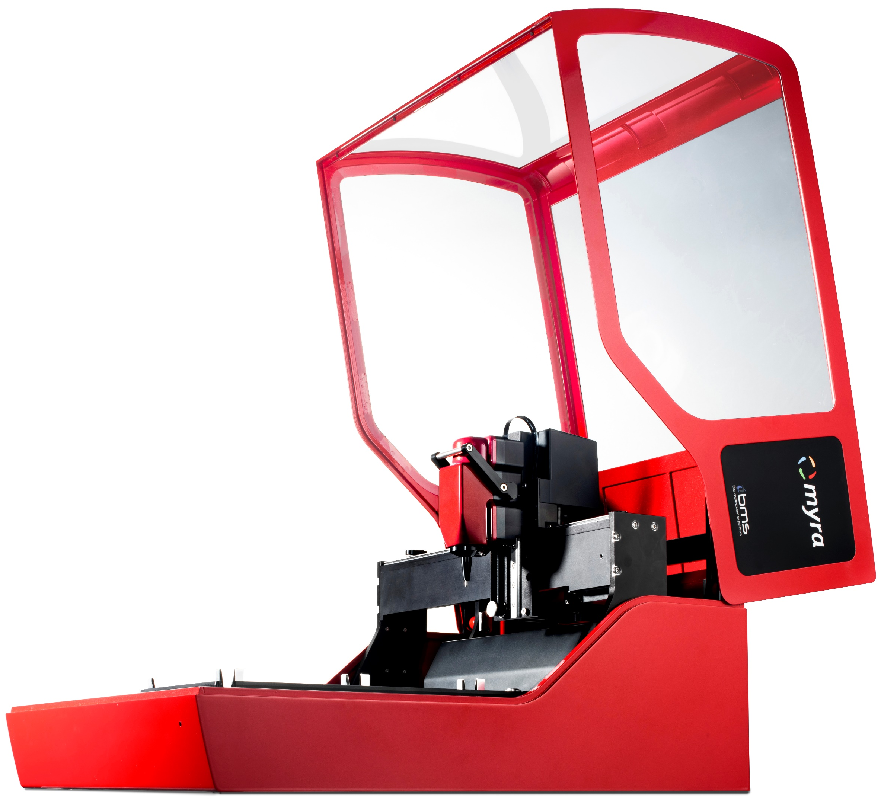
Specifications
Specification | Value
Physical
Dimensions | W: 360 mm, L: 460 mm, H: 310 mm
Weight | 10 kg
Electrical
AC Input | 100 – 240 VAC, 50/60 Hz 4.0 A
Technical
Position control | Closed loop, 100 µm resolution
Level detection | Pressure sensing
Calibration | High precision camera
Pipetting strategy | Single or multi-dispense
Pipette Head
Volume range | 1 – 50 µL
Tips per rack | 384
Precision† | 1 µL: < 10% CV
 | 2 – 50 µL: < 1% CV
Accuracy | 1 µL: < 10%
 | 2 – 50 µL: < 1%
Contamination Control
UV decontamination | High intensity 70 mW 280 nm UV LED
HEPA air filtration | 99.98% at 0.3 µm
Operating Environment
Temperature | 18 – 30°C
Relative Humidity | 20 – 80%

